Slide 1
CSCI 566: Deep Learning and Its Applications
Jesse Thomason
Lecture 9: Deep Learning Agents

Slide 2
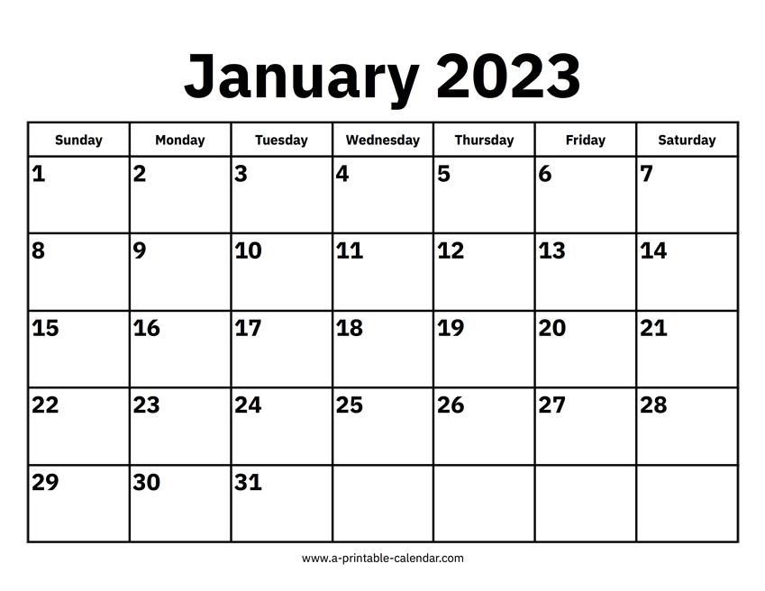
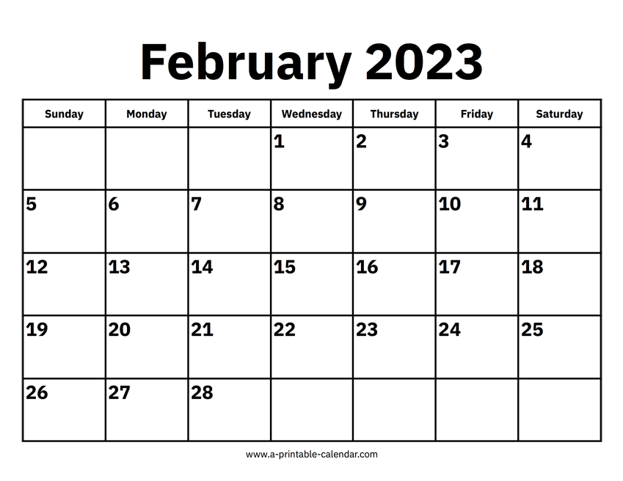
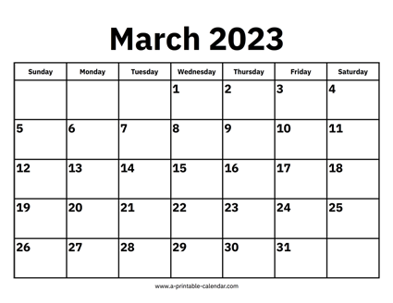
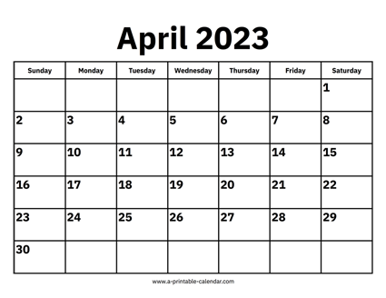


CSCI 566 Roadmap
Module 1: Neural Network Basics
Module 2: Deep Learning Applications
Module 3: Advanced Topics in Deep Learning

Slide 3
[Mar 31] Endgame Deliverables
Assignment 2 Due | April 3
Project Midterm Report | April 3
Paper Roleplaying Breakout Sessions | Mar 31, April 7, April 14
Final Project Presentations | April 21, April 28
Project Final Report | May 3

Slide 4
Project Midterm Reports Due Apr 3, 11:59pm
Details about the set of initial experiments you have done for the project
Can involve a short abstract/introduction
Should involve reproducing the results of a state-of-the-art baseline model for the task of interest with code that you have implemented, or a pilot version of your proposed approach
Talk about the specific dataset(s) you choose to use, the evaluation protocol and metric you decide to have, and the experiment settings.
Perform an analysis of what remaining errors your mid-report model makes and describe how you will approach these by the final report
Format: a 3-page report + contributions page
Syllabus provides suggested format outline and grading breakdown

Slide 5
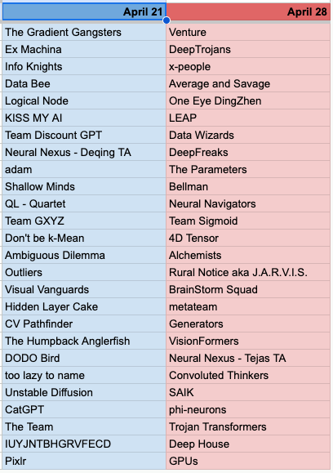
Project Final Presentations: April 21, April 28
Schedule is available now:
Your group will submit to us a multiple choice question about your final presentation, which we’ll use to build quizzes that summarize each day’s presentations.
Project questions are due one week before your scheduled prez date.

Slide 6
Overview of Today’s Plan
Course organization and deliverables
Any questions before we move on?
Lecture 8 Recap
Deep Learning for Agents
March 31st Project Roleplaying Breakouts

Slide 7
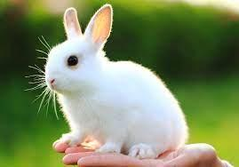
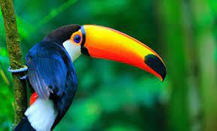
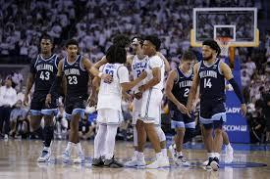
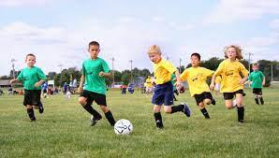

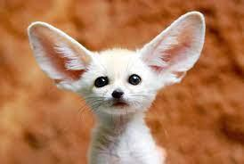
Images and Text for Retrieval
Text Query
Candidate Images
“A tropical bird perches in the jungle.”

Slide 8
Images and Text for Retrieval
Image Query
Candidate Captions
“A rabbit sits in the palm of a hand.”
“Men are talking on a basketball court.”
“A tropical bird perches in the jungle.”
“Children play soccer in a field.”
“A white fox is looking at the camera.”
“Sports equipment is staged for a photo.”

Slide 9
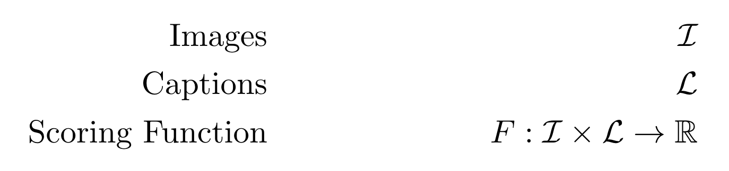
Formulating the Retrieval Problem

Slide 10
Feature Extraction for Language
“A rabbit sits in the palm of a hand.”
“A tropical bird perches in the jungle.”
“Men are talking on a basketball court.”
BOW
a
2
1
1
bird
0
1
0
hand
1
0
0
in
1
1
0
men
0
0
1
on
0
0
1
rabbit
1
0
0
the
0
1
0
…
…
…
…

Slide 11
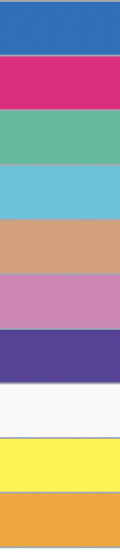
Feature Extraction for Vision
RGB
kNN bins
…
…
…
…

Slide 12
Contextual Information
You shall know a word by the company it keeps (Firth, J. R. 1957:11)
You shall know the features of modality A by the company they keep in the features of modality B. And vice versa.

Slide 13
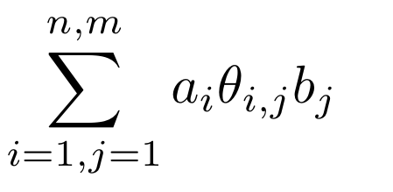
Formulating the Retrieval Problem as a Linear Model
a
bird
2
hand
0
in
1
men
1
on
0
rabbit
0
the
1
Weight of (blue, “a”)
0
Weight of (white, “bird”)

Slide 14
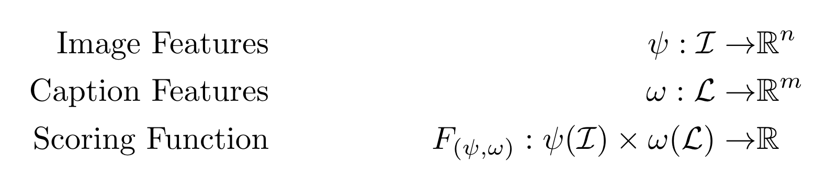
Pretrained Language Token Embeddings
Training
Inference
“A white bunny rabbit held in a green field.”
“A black rabbit watches a red sunset.”

Slide 15
Estimating Joint Distributions
Define F as cosine similarity between image and caption embeddings
Then we can learn:
(minimally) a projection network that maps image embeddings and caption embeddings to the same space
(bonus) an image feature extractor (psi)
(bonus) a language feature extractor (omega)

Slide 16
“A rabbit sits in the palm of a hand.”
“Children play soccer in a field.”
“A white fox is looking at the camera.”
“Men are talking on a basketball court.”
Image Embedder
Caption Embedder
Pull matching image/caption embeddings together.
Push distractor image/caption embeddings apart.
L
L
I
I
L
Learned Projection
Learned Projection
I
L
I

Slide 17
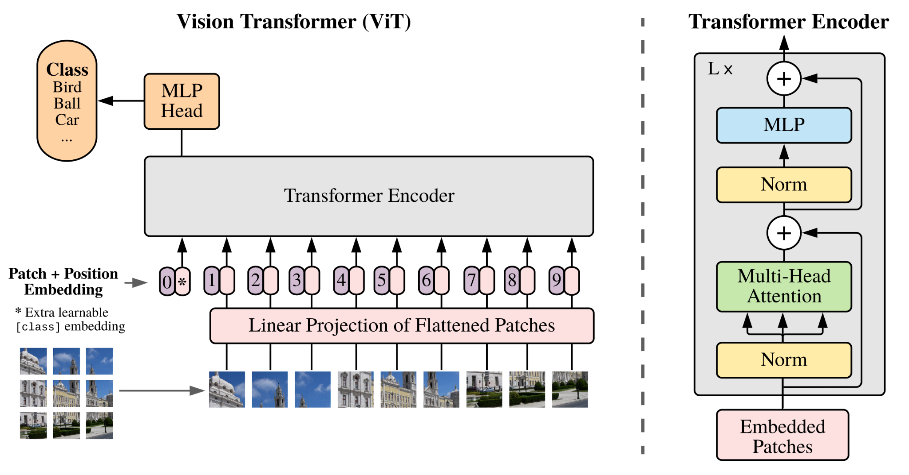
Transformers for Vision: Patches
Learned positional embeddings! :o
An Image is Worth 16x16 Words: Transformers for Image Recognition at Scale

Slide 18
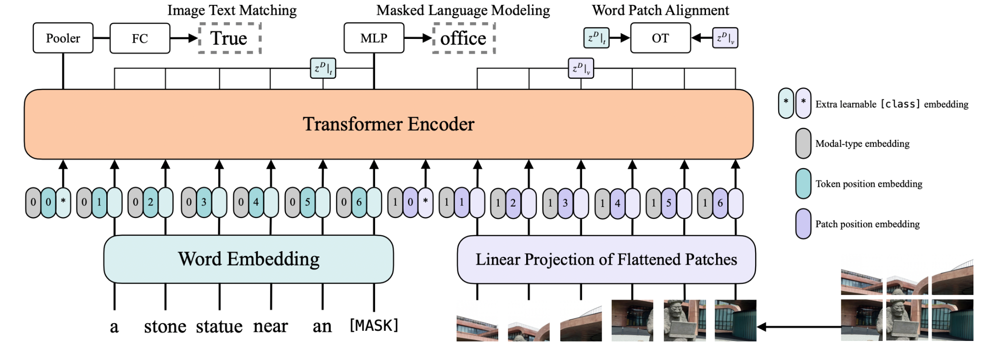
Language and Vision: Patches
ViLT: Vision-and-Language Transformer Without Convolution or Region Supervision

Slide 19
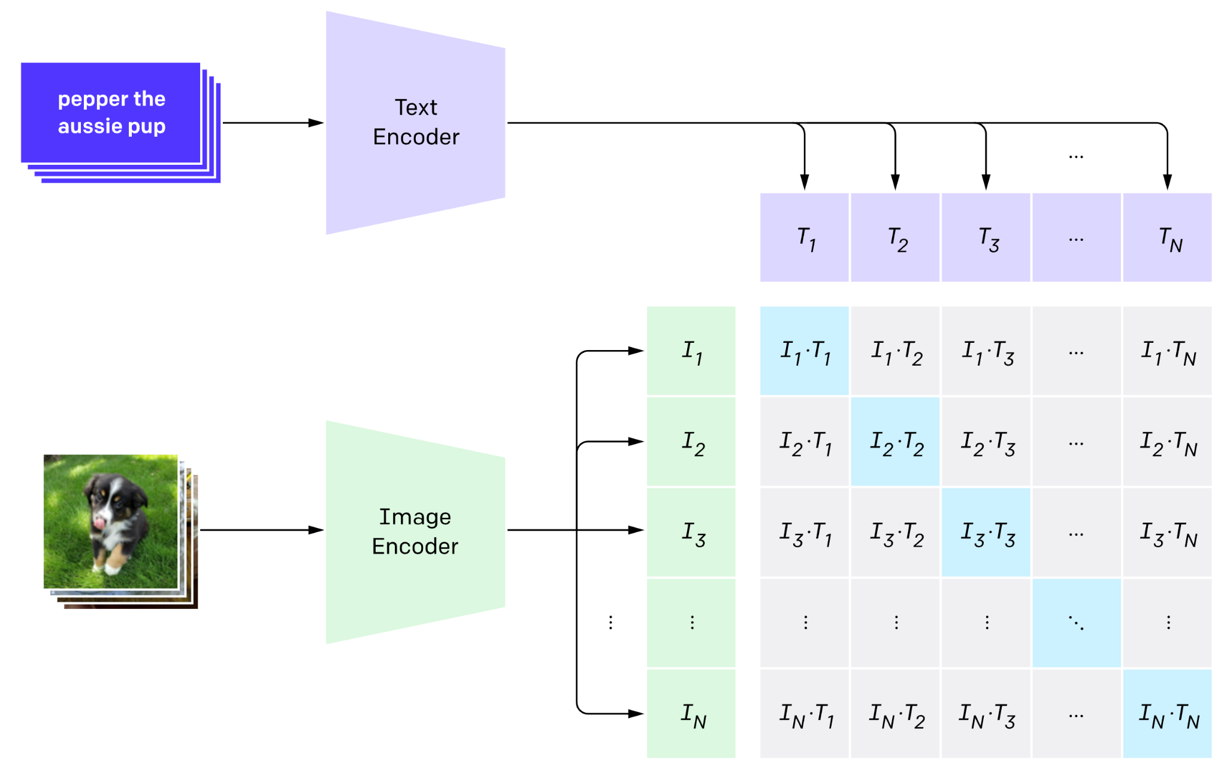
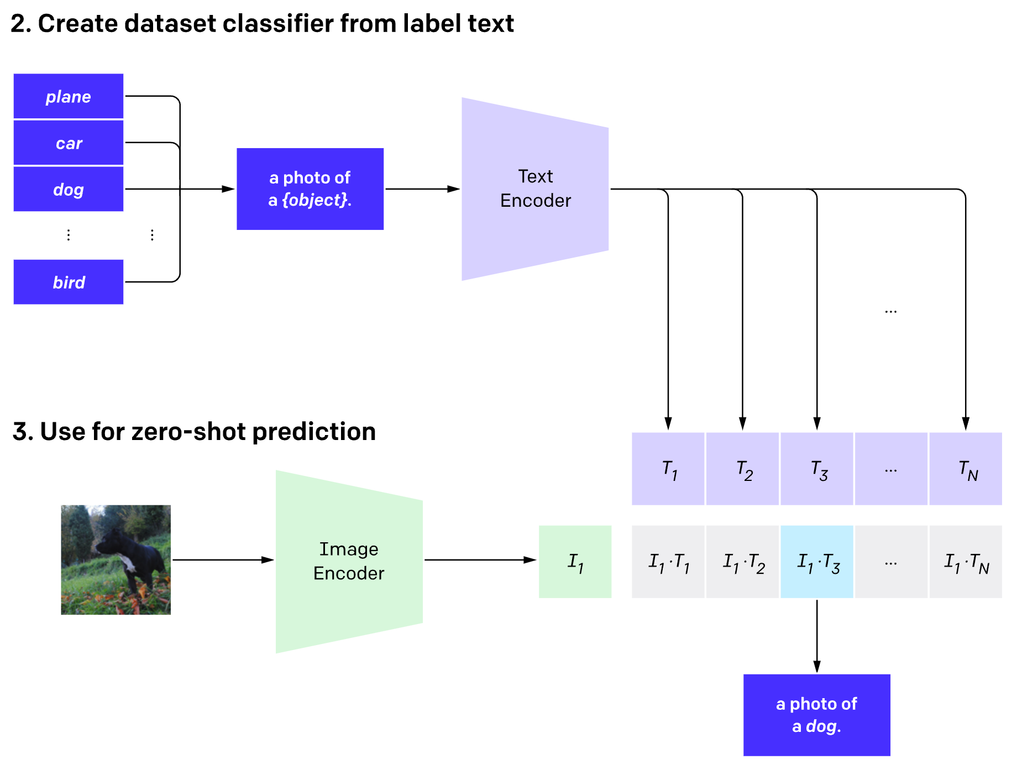
Contrastive Language–Image Pre-training (CLIP)
BPE Tokens into Transformer
Patch-based ViT
Maximize match
https://openai.com/blog/clip/

Slide 20
Overview of Today’s Plan
Course organization and deliverables
Lecture 8 Recap
Any questions before we move on?
Deep Learning for Agents
March 31st Project Roleplaying Breakouts

Slide 21
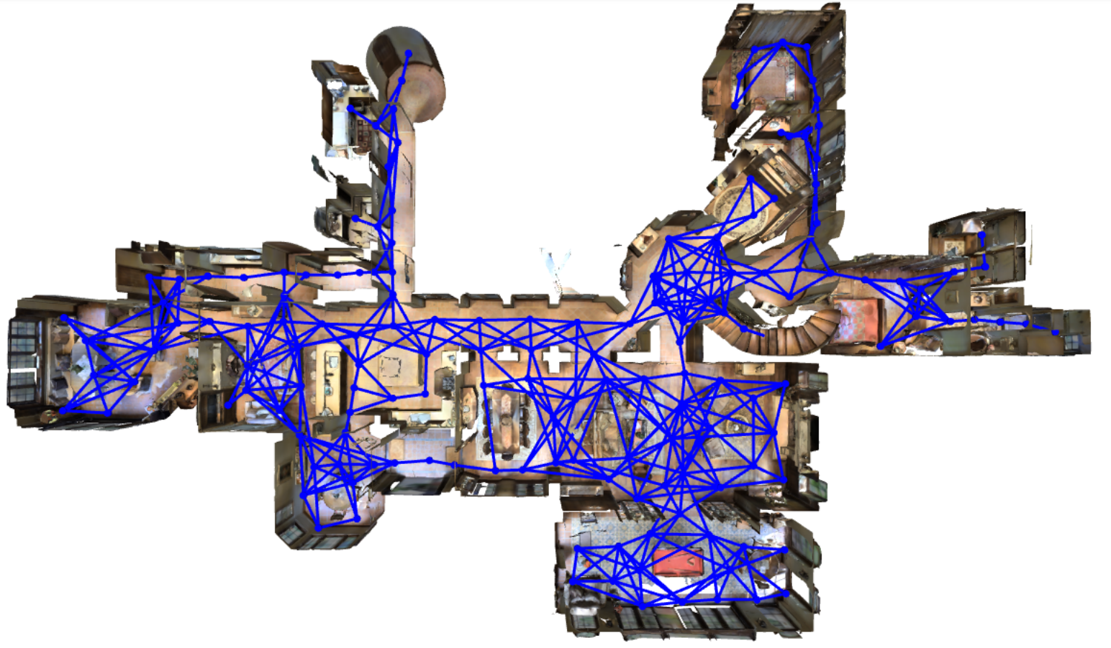
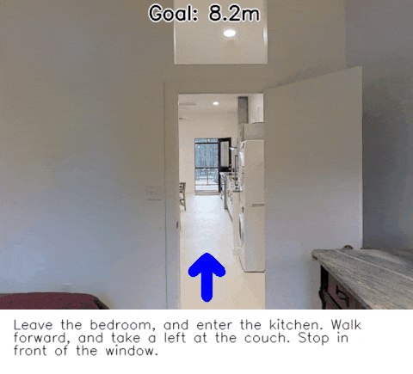
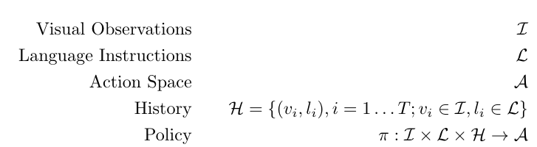
Vision-and-Language Navigation (VLN)
https://bringmeaspoon.org/

Slide 22
World Actions and Consequences
Agents perform sequence prediction
We are no longer taking in input and producing a single output
E.g., retrieval of an image from language
Want to learn a policy 𝛑(a|s) from states to actions
We are taking in observations (e.g., language and vision) and producing one action at a time that causes new observations we can consider; our state is estimated by observations
Open-loop: Produce whole sequence at once
Closed-loop: Consider observations after each action

Slide 23
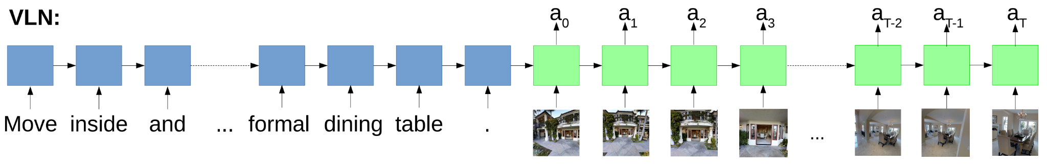
Vision-and-Language Navigation with LSTM
https://bringmeaspoon.org/

Slide 24
Vision-and-Language Navigation with LSTM
The resulting LSTM is a policy from states represented as history so far, image observations, and language instructions to actions in the environment
With training data, this is just supervised learning still; in this community you’ll also see this called imitation learning
https://bringmeaspoon.org/

Slide 25


Vision-and-Language Navigation with LSTM

Slide 26
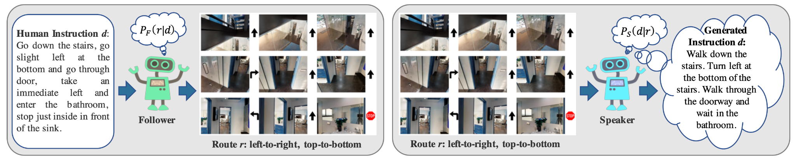
Vision-and-Language Navigation Speaker-Follower
Speaker-Follower Models for Vision-and-Language Navigation

Slide 27
Vision-and-Language Navigation (VLN)
What is our transition function complexity?
Other agents?
Do our actions affect the world?
Do our actions affect our future observations? (e.g., ourself)
What is our state best represented as?
Do we know what state we’re in at each timestep?
No!
We have to estimate our position with respect to the goal based only on image observations

Slide 28
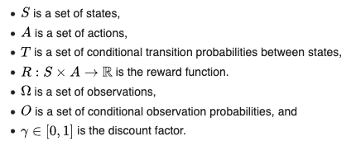
Partially Observable Markov Decision Processes
A discrete-time POMDP models the relationship between an agent and its environment. Formally, a POMDP is a 7-tuple:
S: underlying environment
A: what agent can do
T: how what the agent does changes S
Om: what can be observed by the agent

Slide 29
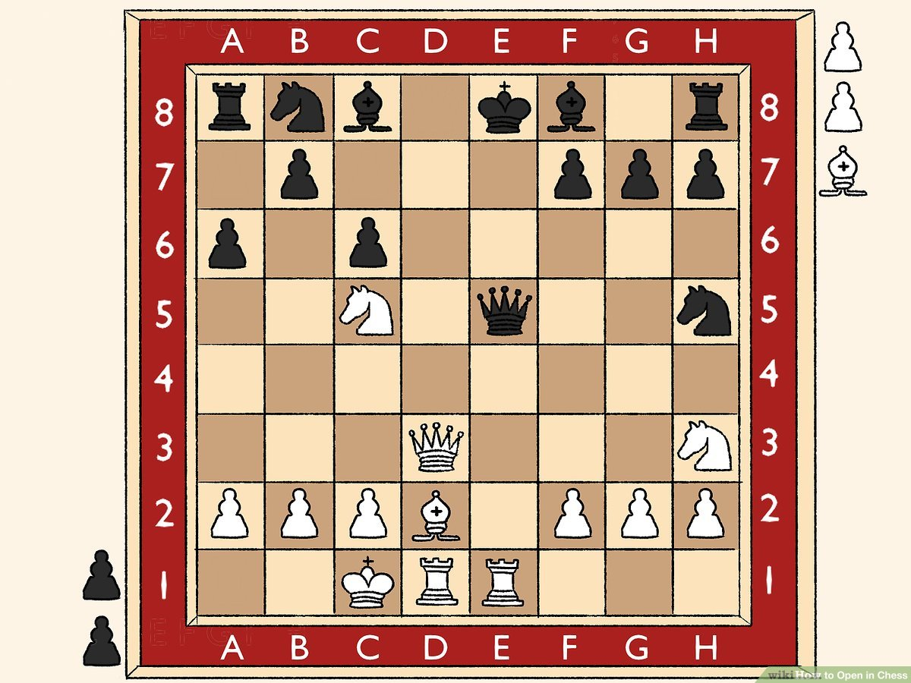
POMDP or MPD?
MDP is a special case of the more general POMDP formulation.
Om == S, observation is full state.
S: underlying environment
A: what agent can do
T: how what the agent does changes S
Om: what can be observed by the agent

Slide 30
Tractable, Discrete State Space; Discrete Action Space
Enumerate nodes + viewpoints; search over graph paths.
Could create open-loop plan since nothing “new” can happen if we’ve mapped everything out.

Slide 31
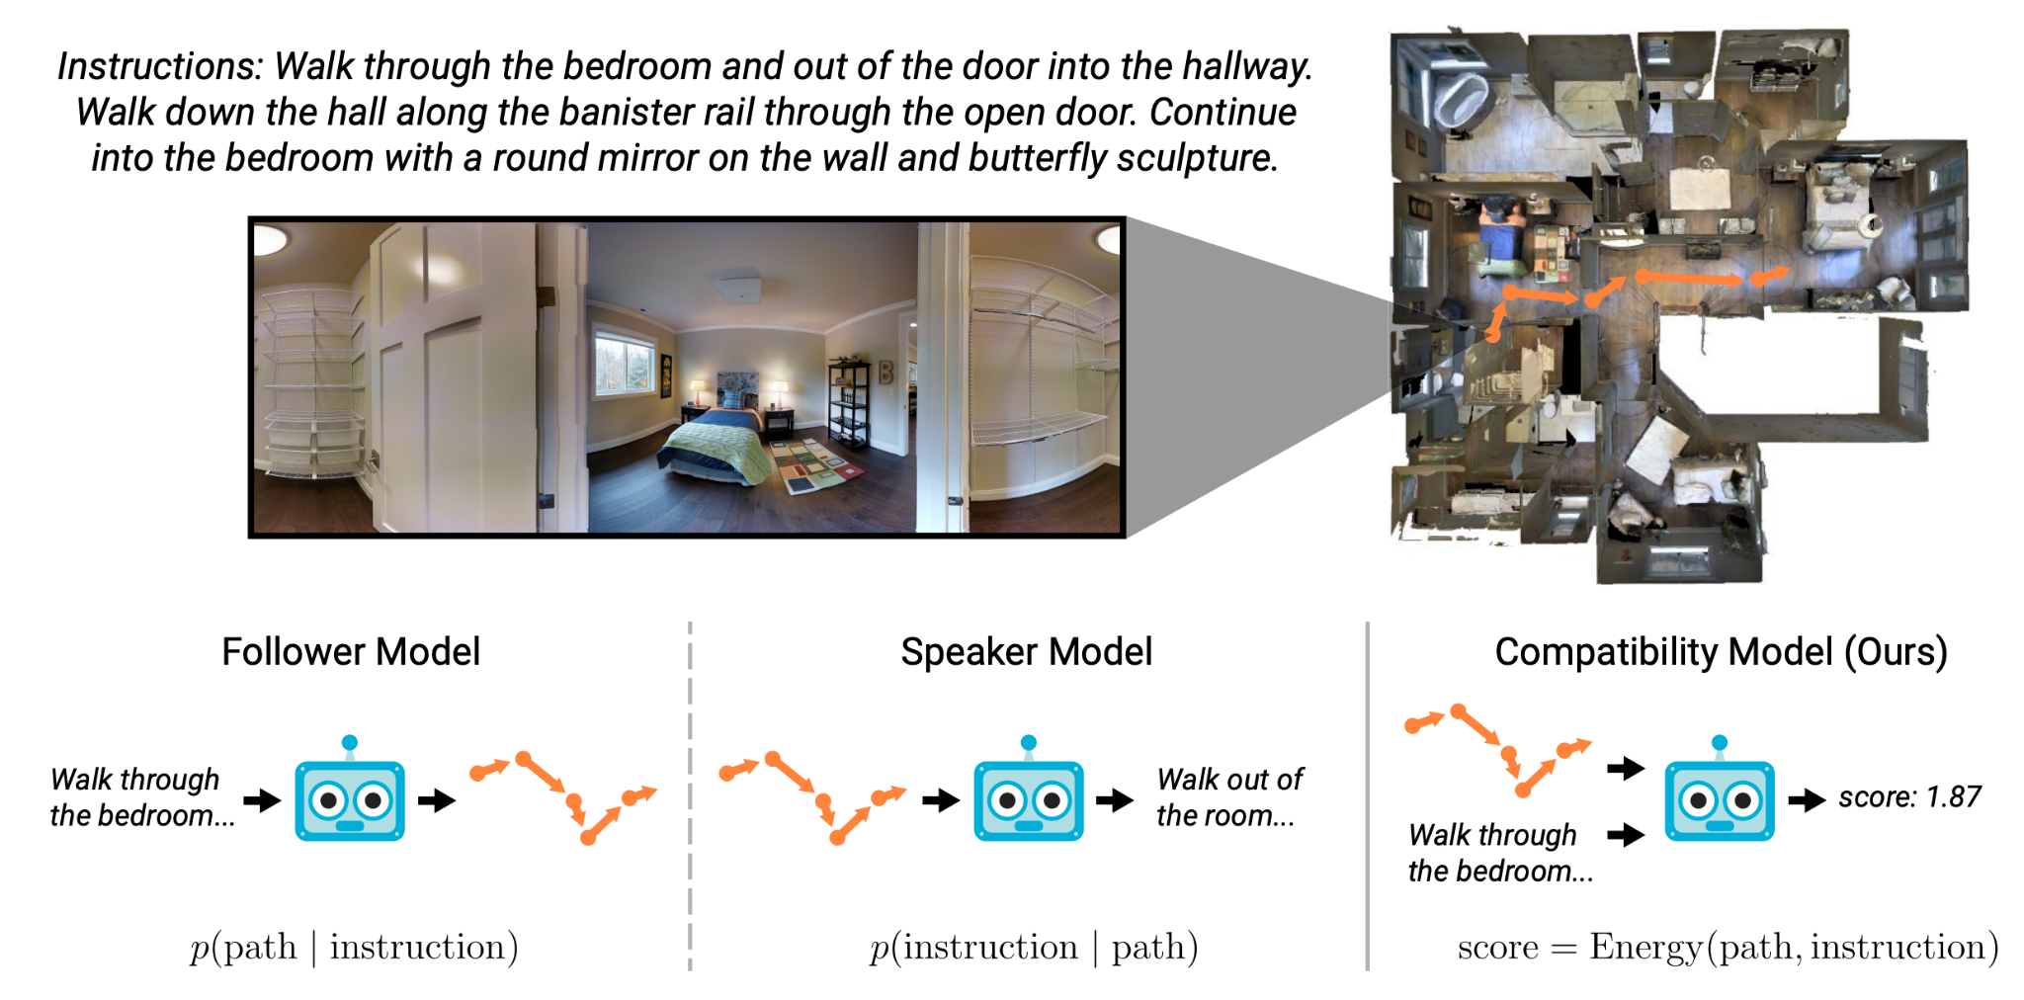
Language and Vision and “Time”
Improving Vision-and-Language Navigation with Image-Text Pairs from the Web

Slide 32
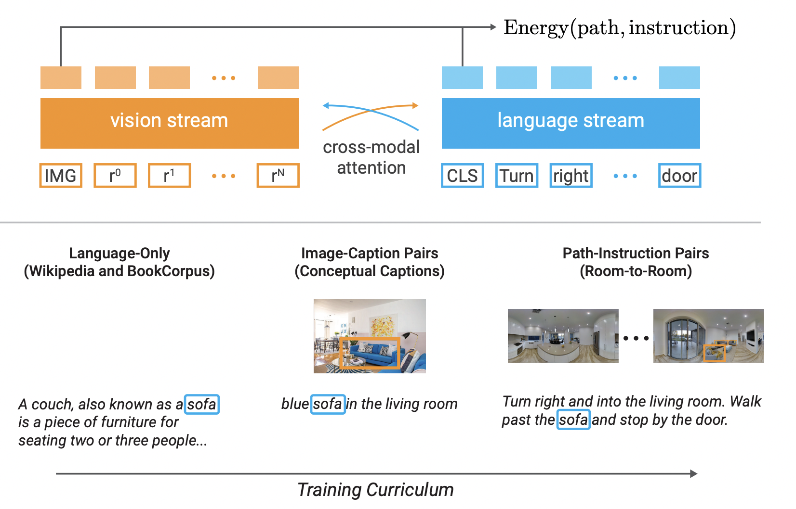
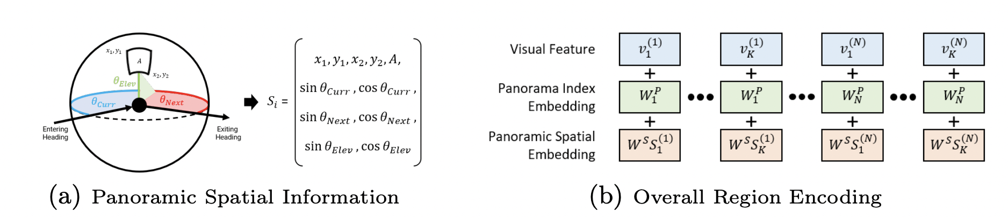
Language and Vision and “Time”
Improving Vision-and-Language Navigation with Image-Text Pairs from the Web

Slide 33
Tractable, Discrete State Space; Discrete Action Space
Use the follower model to generate k possible paths
Use the learned scoring model to calculate the path with the highest “energy” against the instruction and walk it
Improving Vision-and-Language Navigation with Image-Text Pairs from the Web

Slide 34
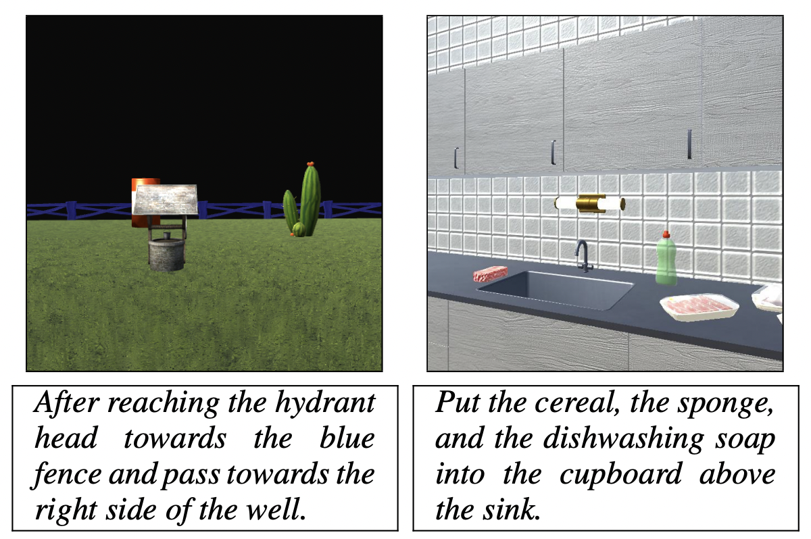
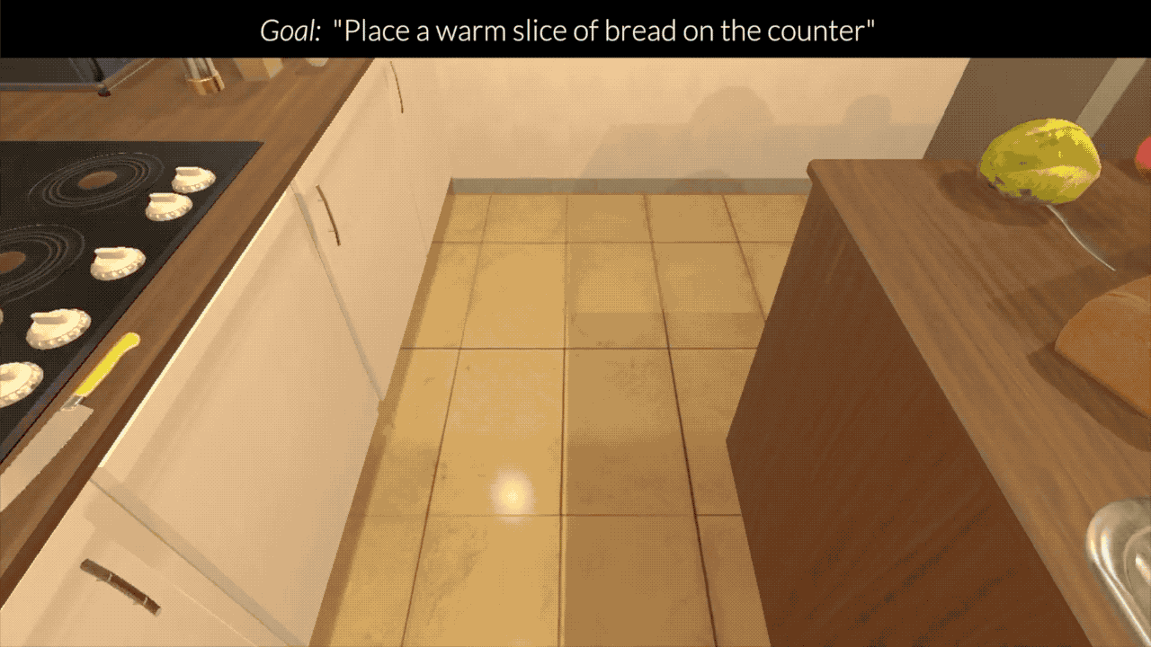
Language-guided Task Completion
Brown a potato slice. Turn left and head to the stove counter. Pick up the knife on the counter beside the toaster. Turn right then face to the island. Slice the potato. ...
CHALET
[Misr et al., EMNLP 2018]
ALFRED
[Shridhar et al., CVPR 2020]

Slide 35
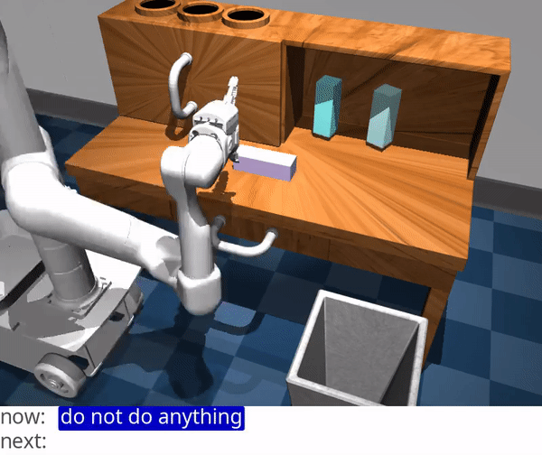
Language-guided Task Completion
https://language-play.github.io/

Slide 36
AI FUNDAMENTALS: Discrete and Continuous Space
Continuous A: there does not exist an injective map to Natural Numbers, but exists one to Reals.
Discrete A: there exists an injective map from A to Natural Numbers
θ
1
1
2
2
m
3
3
4
4
F(a, θ, m): {θ if a=turn; m+2π if a=forward}
F(a) = {1 if a=forward; 2 if a=left; 3 if a=right}

Slide 37
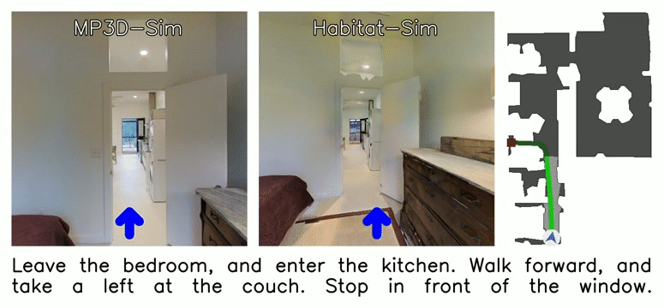
Discrete Actions, Continuous State Spaces
https://github.com/jacobkrantz/VLN-CE

Slide 38
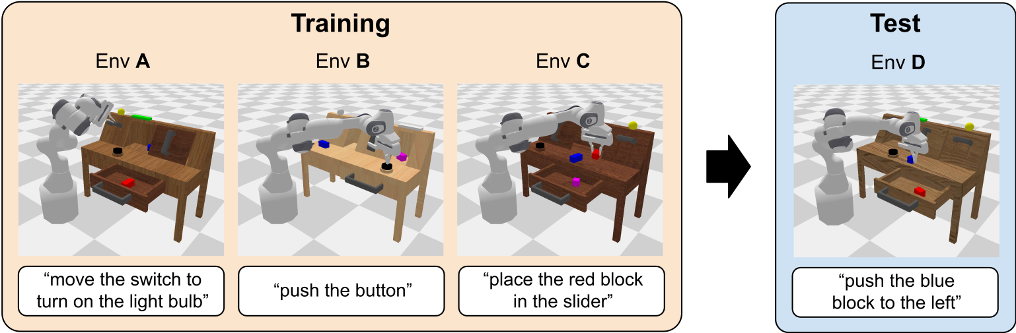
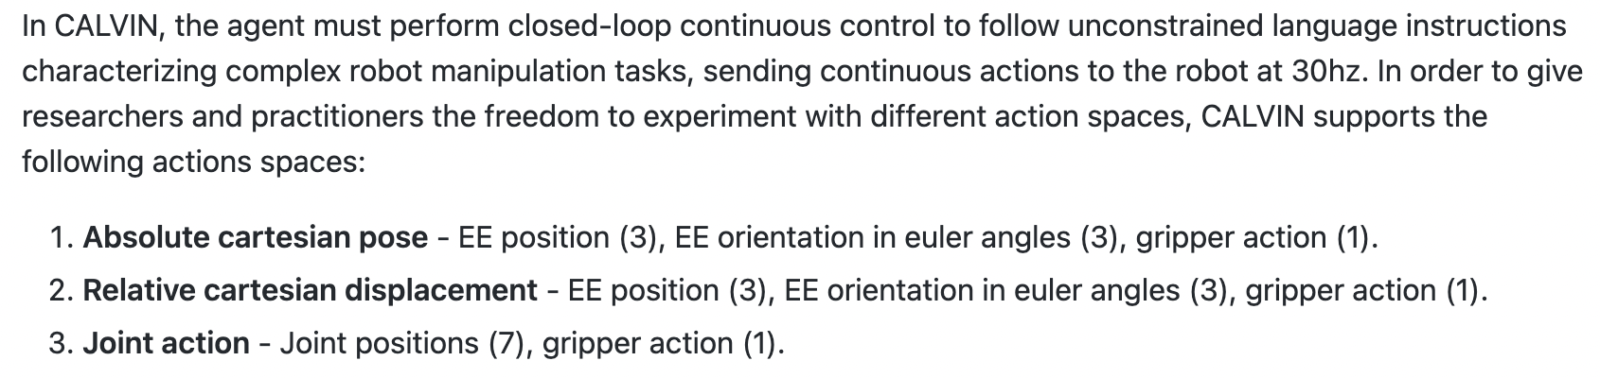
Continuous Action and State Spaces
https://github.com/mees/calvin

Slide 39
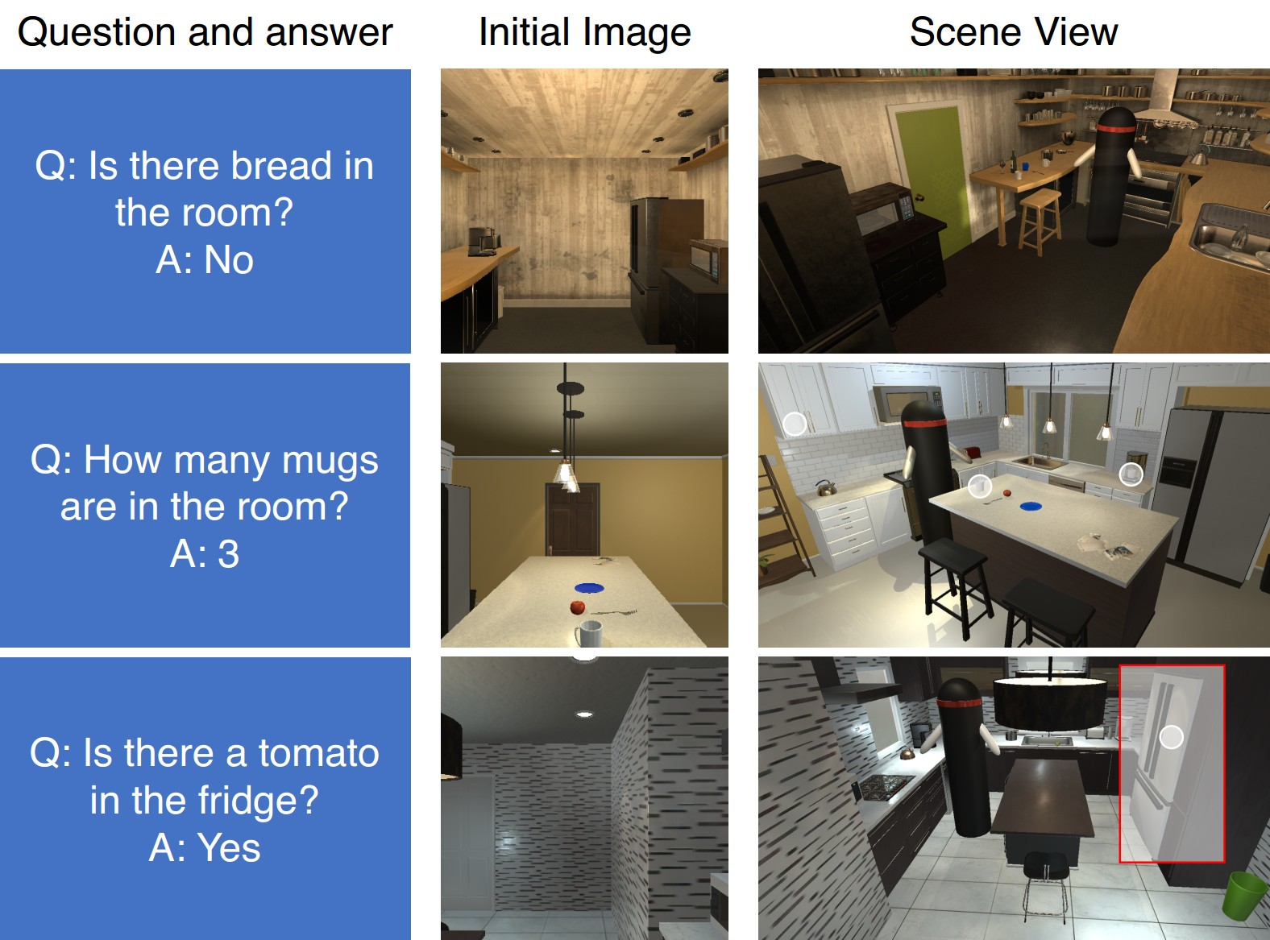

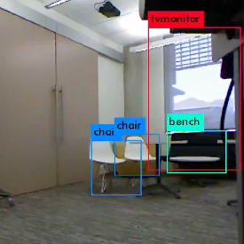
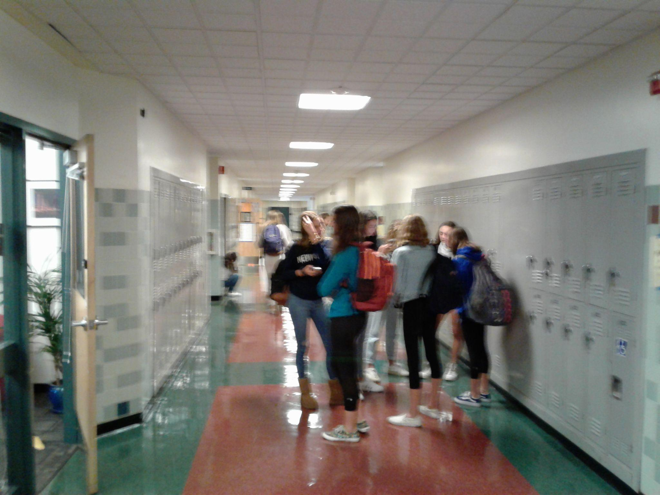
A Loose Taxonomy for Embodied AI
Task Specification Observation
Sensory Observation
Underlying State
Action Space
Transition Dynamics
➡️ ⬆️
“What color is the car?”
“Find a teddy bear on an office chair.”
Actions that adjust agent state only.
Deterministic
“Boil a potato.”
Agent position and orientation (state)
Simulation Render
Goal-based / Implicit / High-level
🚪 🔪
Actions that affect object states.
“Turn around and exit the bathroom, walk down the hall and stop at the …”
🗣️ 🥺
Probabilistic
Agent state and object states
Actions that affect other agent states.
Simulation Photo
“First, go to the counter and pick up the shallow pot, then turn around and turn on the sink…”
🚗 🦾
Instruction-based / Explicit / Low-level
Continuous versus discrete actions.
Multi-agent states, object states, …
Environment Dynamics
Mounted Camera

Slide 40
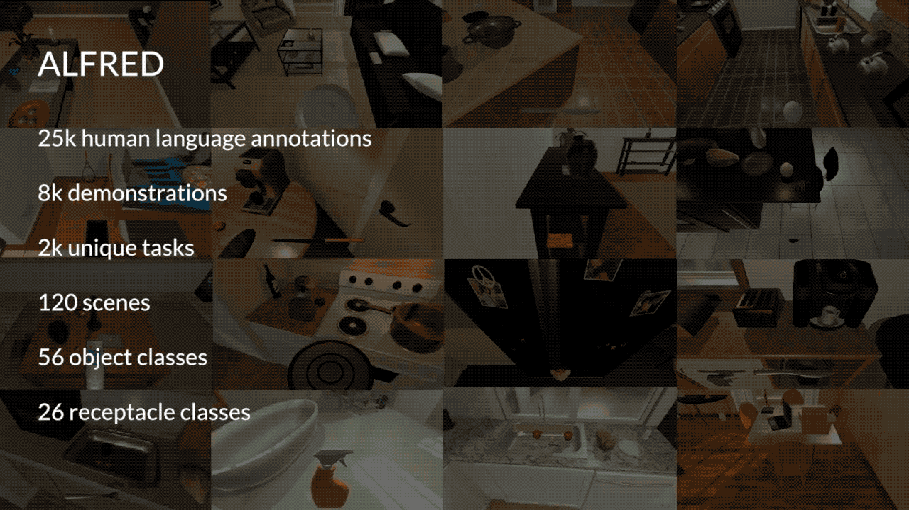
ALFRED Tasks
https://askforalfred.com/

Slide 41
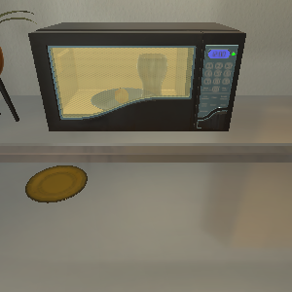
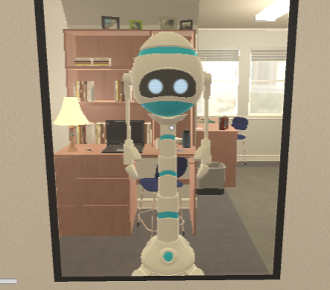
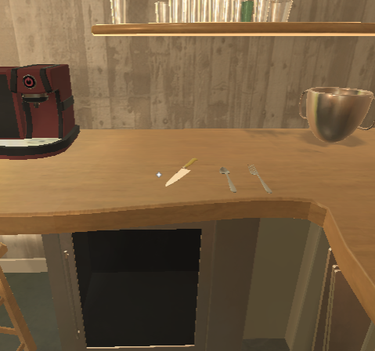
Can We Do Open Loop Planning + Scoring In this Space?
Navigate on a grid of occupiable space.
…

Slide 42
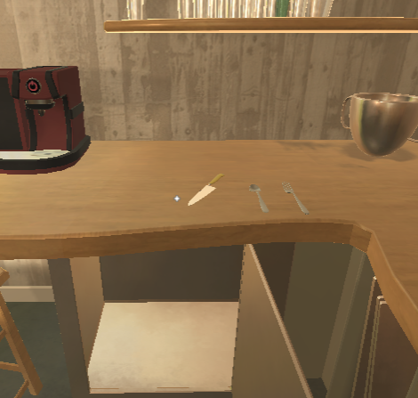
Can We Do Open Loop Planning + Scoring In this Space?
Consider object states.
…

Slide 43
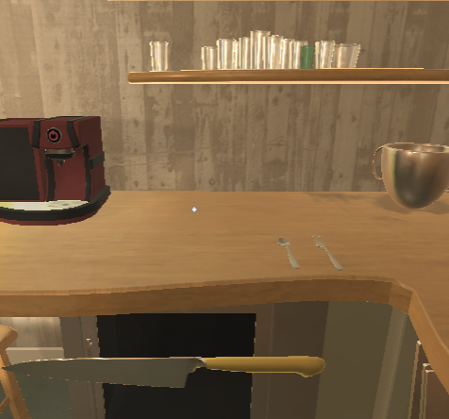
Can We Do Open Loop Planning + Scoring In this Space?
Consider object positions.
…

Slide 44
Intractable, ~Discrete State Space with Discrete Actions
Positions are continuous in AI2THOR
Descritized, still ~N^(1+MK) states
For N=100, M=20, K=3, number of states ~1e+122
…

Slide 45
High-level instructions provide hints about a goal
“Brown a potato slice.”
…

Slide 46
Low-level instructions provide hints to a “path”
“Pick up the knife on the counter beside the utensils, then turn right to face the island…”
…

Slide 47
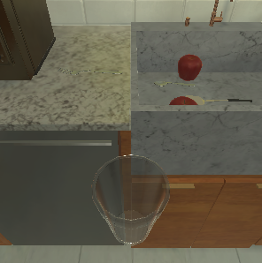
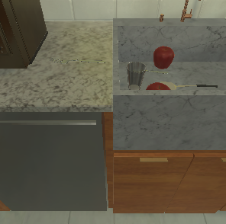
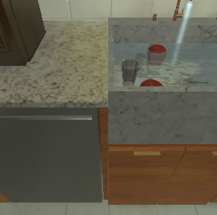

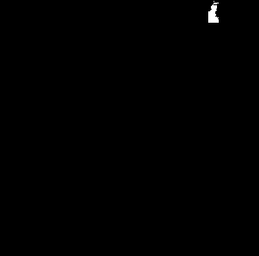
Action and State Space
Chain together low-level actions to accomplish goals.
Navigation + Manipulation actions:
Predict an interaction mask (wrapper for AI2THOR).
Put In
Toggle On

Slide 48
ALFRED Seq2Seq
Put In
Language Instructions Encoding (t=0)
a_{t} ; m_{t}
Put a chilled cup of water in the cupboard. Take a step to your right then walk to the counter in front of you then turn right and walk to the fridge. Open the freezer and grab the glass from behind the egg then close the door. Turn around and walk to the counter then turn right. Put the cup in the sink then full it with water and pick it back up remembering to shut off the tap. ...
x_{t}
Action Decoder
BiLSTM Encoder
Attention over x
x₁
x₂
x₃
...
x_{L}
x
h_{t}
Visual Encoding (t)
v_{t}
LSTM
Encoding
Resnet Conv5
a_{t - 1}

Slide 49
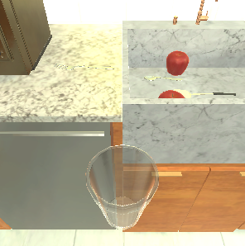
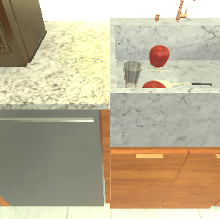
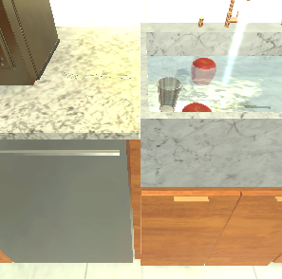
ALFRED Seq2Seq
Put In
Toggle On
Language Directive Encoding
Put a chilled cup of water in the cupboard. Take a step to your right then walk to the counter in front of you then turn right and walk to the fridge. Open the freezer and grab the glass from behind the egg then close the door. Turn around and walk to the counter then turn right. Put the cup in the sink then full it with water and pick it back up remembering to shut off the tap. ...
...
ResNet
ResNet
ResNet
BiLSTM Encoder

Slide 50
ALFRED Seq2Seq
Put In
Language Instructions Encoding (t=0)
a_{t} ; m_{t}
Put a chilled cup of water in the cupboard. Take a step to your right then walk to the counter in front of you then turn right and walk to the fridge. Open the freezer and grab the glass from behind the egg then close the door. Turn around and walk to the counter then turn right. Put the cup in the sink then full it with water and pick it back up remembering to shut off the tap. ...
x_{t}
Action Decoder
BiLSTM Encoder
Attention over x
x₁
x₂
x₃
...
x_{L}
x
h_{t}
Visual Encoding (t)
S: underlying environment
A: what agent can do
T: how what the agent does changes S
Om: what can be observed by the agent
LSTM
v_{t}
Encoding
Resnet Conv5
a_{t - 1}

Slide 51
Why Would We Use an LSTM Anymore?
Can we formulate language in, action policy out problems using Transformers?
Let’s think through what Transformers gain us and what they lose us compared to recurrent architectures

Slide 52
The Key Ingredient of the Transformer over the RNN
[1, 2]
Encode/decode sequences of size N,M
Transformer: M forward passes
RNN: N+M forward passes
2
1
Decoder
Dec
Dec
Encoder
Enc
Enc
Enc
Enc
Enc
{(a, i1), (b, i2), (c, i3), (d, i4)}
a
b
c
d
[EOS]

Slide 53
The Key Ingredient of the Transformer over the RNN
[1, ∅, 3, ∅]
Encode size N, decode multiple tokens
Transformer: one forward pass
RNN: stuck at N+M
Need to decode whole sequence, token by token, to update state for next prediction.
Can’t “take advantage” of decoder ‘given’ tokens to speed training.
Decoder
Encoder
4
3
2
1
{(a, i1), (b, i2), (c, i3), (d, i4)}
Dec
Dec
Dec
Dec

Slide 54
The Key Ingredient of the RNN over the Transformer
Encoder
Enc
Enc
Enc
Enc
Enc
{(a, i1), (b, i2), (c, i3), (d, i4)}
a
b
c
d
[EOS]
RNN creates one state per input
Transformer inputs are interdependent
Encoder
…
Enc
Enc
Enc
{(a, i1), (b, i2), (c, i3), (d, i4), (e, i5)}
d
e
[EOS]

Slide 55
Who cares if there’s a state?
RNN operates on a sequence and compresses each input into a continually refined state from which to decode
Word sequences [e.g., Machine Translation]
Image sequences [e.g., Video Understanding; VLN]
Assumption: state sufficiently represents the entire past
Transformer operates on a set, compresses the whole set interdependently into an embedding from which to decode
Spatially and temporally embedded inputs (words, regions)
Assumption: all output depends on all input

Slide 56





Who cares if there’s a state?
Let’s look at an ALFRED example
Goal: Put a cold egg in the sink.
Inst: Cross the kitchen, go between the counter and the stove, then turn to the right and face the sink.
Pick up the egg from in the sink.
Bring the egg with you to go face the white fridge.
Open the fridge and put the egg inside, close the door and let it get cool, then take the egg back out of the fridge.
Bring the egg with you and go back over to face the sink.
Put the egg back in the sink.
https://askforalfred.com/?vid=42478

Slide 57
Who cares if there’s a state?
Probably your compute constraints
Goal: Put a cold egg in the sink.
… t-1
Transformer
Inst: Cross the kitchen, go between the counter and the stove, then turn to the right and face the sink.
Pick up the egg from in the sink.
t
RNN
https://askforalfred.com/?vid=42478

Slide 58
The quality of your learned state can be crucial
Goal: Put a cold egg in the sink.
… t-1
Transformer
Inst: Cross the kitchen, go between the counter and the stove, then turn to the right and face the sink.
Pick up the egg from in the sink.
Bring the egg with you to go face the white fridge.
Open the fridge and put the egg inside, close the door and let it get cool,
then take the egg back out of the fridge.
RNN
t
https://askforalfred.com/?vid=42478

Slide 59
The quality of your learned state can be crucial
Forward
Pickup
Open
Close
Open
Pickup
Action Pred
Action Pred
Action Pred
Action Pred
Action Pred
Action Pred
RNN
RNN
RNN
RNN
RNN
RNN
{inst text}
{inst text}
{inst text}
{inst text}
{inst text}
{inst text}

Slide 60
Without States, Our Transformer has to Learn So Much!
Forward
Pickup
Open
Close
Open
Pickup
Transformer
Transformer
Transformer
Transformer
Transformer
Transformer
{inst text}
{inst text}
{inst text}
{inst text}
{inst text}
{inst text}

Slide 61


Stateful Transformers: VLN
https://arxiv.org/abs/2011.13922

Slide 62

Stateful Transformers: ALFRED
https://arxiv.org/abs/2108.04927

Slide 63


Implicit and Explicit States
https://arxiv.org/abs/2108.04927 ; https://arxiv.org/abs/2107.05612; https://arxiv.org/abs/2110.07342

Slide 64

ALFRED Semantic Mapping
https://hlsm-alfred.github.io/

Slide 65
Deep Learning for Agents
So far, we’ve talked about situations where we have demonstrations available as training data
Enables us to perform learning from demonstrations / imitation learning / supervised learning
What if we have no demonstrations, just a binary signal that tells us something like “yep, you completed the goal” or “nope, it’s not done yet”?
Then we move into the realm of reinforcement learning

Slide 66
Overview of Today’s Plan
Course organization and deliverables
Lecture 8 Recap
Deep Learning for Agents
Any questions before we move on?
March 31st Project Roleplaying Breakouts

Slide 68
Action Items for You
Your project midterm reports are due Apr 3 11:59pm
Assignment 2 is also due Apr 3 11:59pm
For those doing a Paper Roleplaying Breakout session today, turn in your 2-page paper role report by 11:59pm tonight through the gDrive submission form

Slide 69
Paper Roleplaying Breakouts: March 31 [Schedule]
On the Dangers of Stochastic Parrots: Can Language Models Be Too Big? 🦜 (Lounge outside of THH 201; find Jesse)
Neural Word Embedding as Implicit Matrix Factorization (Back of THH 201; find Deqing)
CLIPort: What and Where Pathways for Robotic Manipulation (Front of THH 201; find Gautam)
Learning Transferable Visual Models From Natural Language Supervision (Virtual; join Shihan)
Auto-Encoding Variational Bayes (Virtual; join Ayush)

Slide 70
CSCI 566: Deep Learning and Its Applications
Jesse Thomason
Lecture 9: Deep Learning Agents

